Slide 1
(Dec 21, 2016)
Exploiting Expertise Rules for Statistical
Data-Driven Modeling
Cheng Jianlin
Notes:
利用专业(专家)规则来进行统计数据驱动建模
对于复杂的工业过程而言，数据的获取不仅费时而且费力，所以通常数据量是很少的。所以如何利用有限的训练样本去建立复杂的模型显得很重要。
最近这几年，大家用的比较多就是非线性模型，对于非线性模型来说，虽然说它们能对于小数据进行有效的建模，取得不错的效果，但是它们缺少透明度，可理解性比较差。
这篇文章的思路就是，在原来非线性模型的基础上加入专家规则，可以有效地提高数据驱动建模能力。 最后这篇文章用了三个实验来证明这个它们提出的模型是有效的。

Slide 2

Why add Rules?
· they are human readable and interpretable
· they can easily be edited since decision makers can sift through
all these rules to edit and update according to their own needs

Slide 3
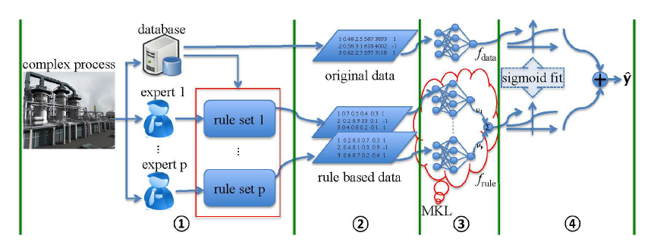

Slide 4
Outline
I. Rule based Data Expression
II. Rule based Data Fusion by l2 Multiple Kernel Learning
III. Ensemble Data and Rule based Model by Sigmoid Fitting
IV. Results

Slide 5
I. Rule based Data Expression
CART is used as a preprocessing step to extract if· · · then· · · rules.

Slide 6
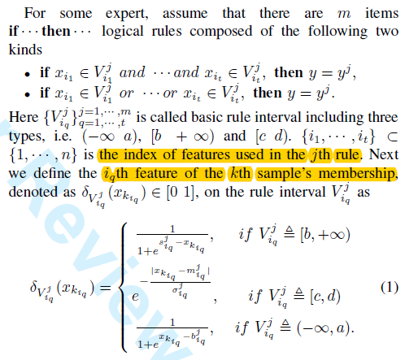
I. Rule based Data Expression

Slide 7
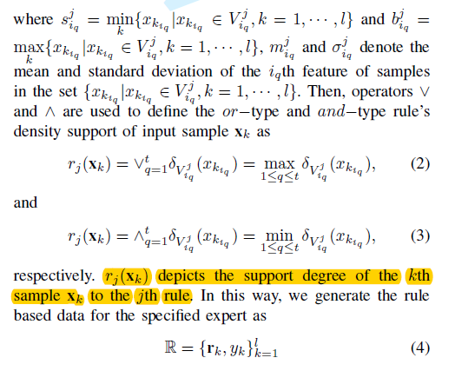
I. Rule based Data Expression

Slide 8
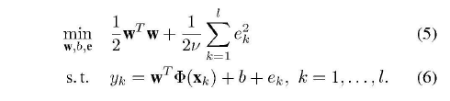

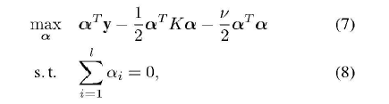
II. . Rule based Data Fusion by l2 Multiple Learning

Slide 9


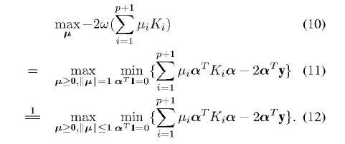
II. . Rule based Data Fusion by l2 Multiple Learning

Slide 10
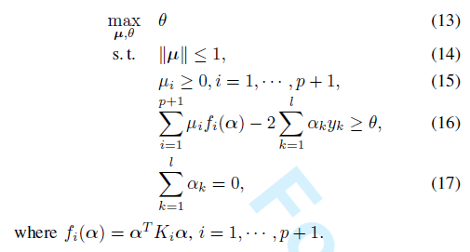
II. . Rule based Data Fusion by l2 Multiple Learning

Slide 11


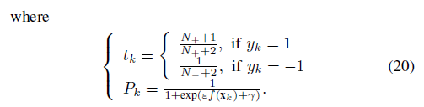
III. Ensemble Data and Rule based Model by Sigmoid Fitting

Slide 12

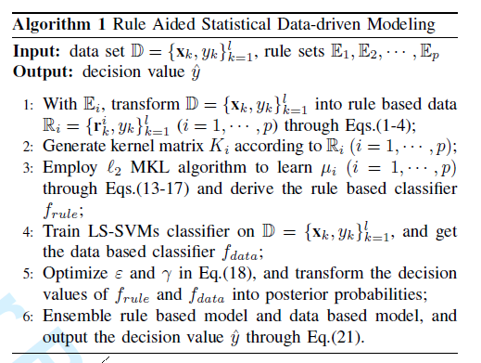
III. Ensemble Data and Rule based Model by Sigmoid Fitting

Slide 13
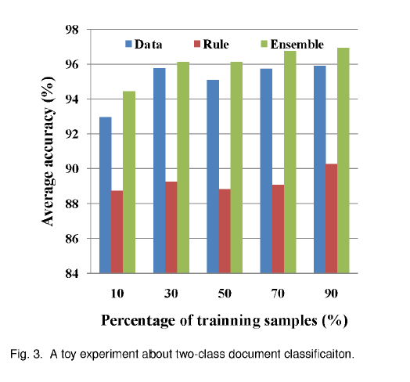
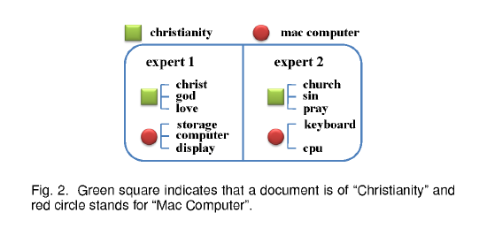
IV. Results
· A Toy Experiment

Slide 14
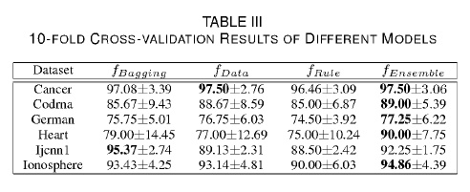
IV. Results
·Evaluating the Performance on Benchmark Datasets

Slide 15
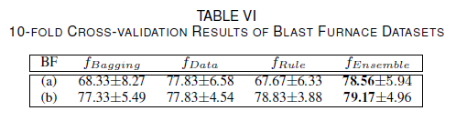
IV. Results
·Tendency Prediction of Thermal State of Blast Furnace

Slide 16
Bibliography
[1] Exploiting Expertise Rules for Statistical Data-Driven Modeling

Slide 17




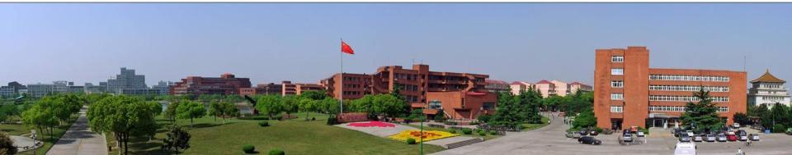




Thanks！

Slide 18
·模型结构图

Slide 19
·创新点
I. Rule Extraction through Decision Tree and how to transform the origin data into rule based data according to the expertise rules
II. Rule based Data Fusion by Multiple Kernel Learning

Slide 20
·意义
I. Improve the model
II. Make the model more understandable

Slide 21
·方法的有待提高的点
I. The weights of two models are equal
Notes:
一： 从正常数据和某个故障数据中通过决策树提取一些专家规则（不能把所有的故障数据归为一类，这样肯定提取不到有用的专家规则了）
二： 对数据进行一定的转换，然后训练它，但这其实就是一个分类问题了
三：可能需要分析一些数据的一些特性也就是具体每个特征和类别的关系了
四：可能不是很适合我们要解决的问题

